Slide 1




NEXT GEN EMPLOYABILITY PROGRAM
Creating a future-ready workforce
Team Members
College Name
Student Name :priyadharshini.s
Student ID :au912421104031
SEC

Slide 2

CAPSTONE PROJECT SHOWCASE
Project Title
VOTING APPLICATION USING DJANGO FRAMEWORK-priyadharshini(4031,sec)
Abstract | Problem Statement | Project Overview | Proposed Solution | Technology Used | Modelling & Results | Conclusion

Slide 3
Abstract:Django online voting system We will create a pollster (voting system) web application using Django. This application will conduct a series of questions along with many choices. A user will be allowed to give voting for that question by selecting a choice. Based on the answer the total votes will be calculated and it will be displayed to the user. Users can also check the result of the total votes for specific questions on the website directly. We will also build the admin part of this project. Admin user will be allowed to add questions and manage questions in the application.
Source :

Slide 4
Problem Statement
A solid understanding of the Python programming language and the Django web framework is necessary.
A strong understanding of HTML, CSS, and JavaScript is required to develop the project’s user interface.
Relational Database: You will need to have a good understanding of relational databases, such as SQLite, MySQL, or PostgreSQL, to create and manage the database for the Online voting system project.
Source :

Slide 5
Project Overview
Application name : Voting Application
Category :Web application
Features :
1)conduct polls with questions and multiple choices
2)Allow user to vote for their preferred choice
3)Display the votes for each questions
4)admin panel for adding and managing questions
Technologies Used:
Django Framework to create a backend and handle database
SQLite Database Django come with sqlite by default
Source :

Slide 6
Proposed Solution
Project Setup:
Start a new Django project: django-admin startproject voting_app.
Create a new Django app for the voting functionality: python manage.py startapp vote.
Models:
Define models for your voting system. For example, you might have a Poll model to represent each poll and a Choice model to represent the choices for each poll.
Source :

Slide 7
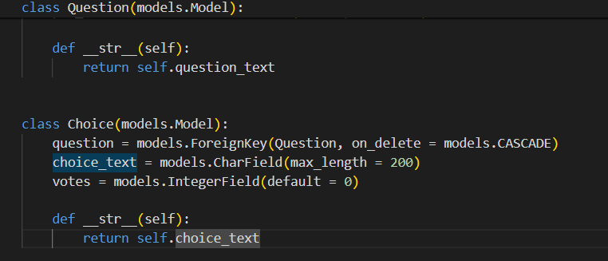
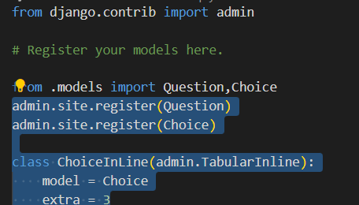
1.models.py
2.admin.py

Slide 8
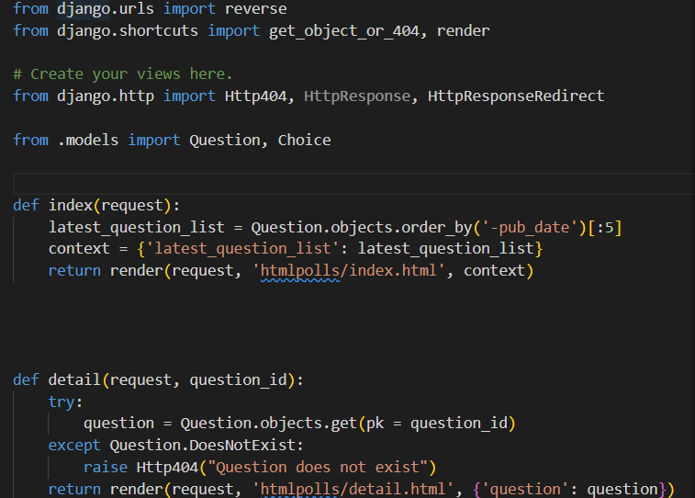
Views.py
Source :

Slide 9


Technology Used
Front-end
Back-end
Source :

Slide 10
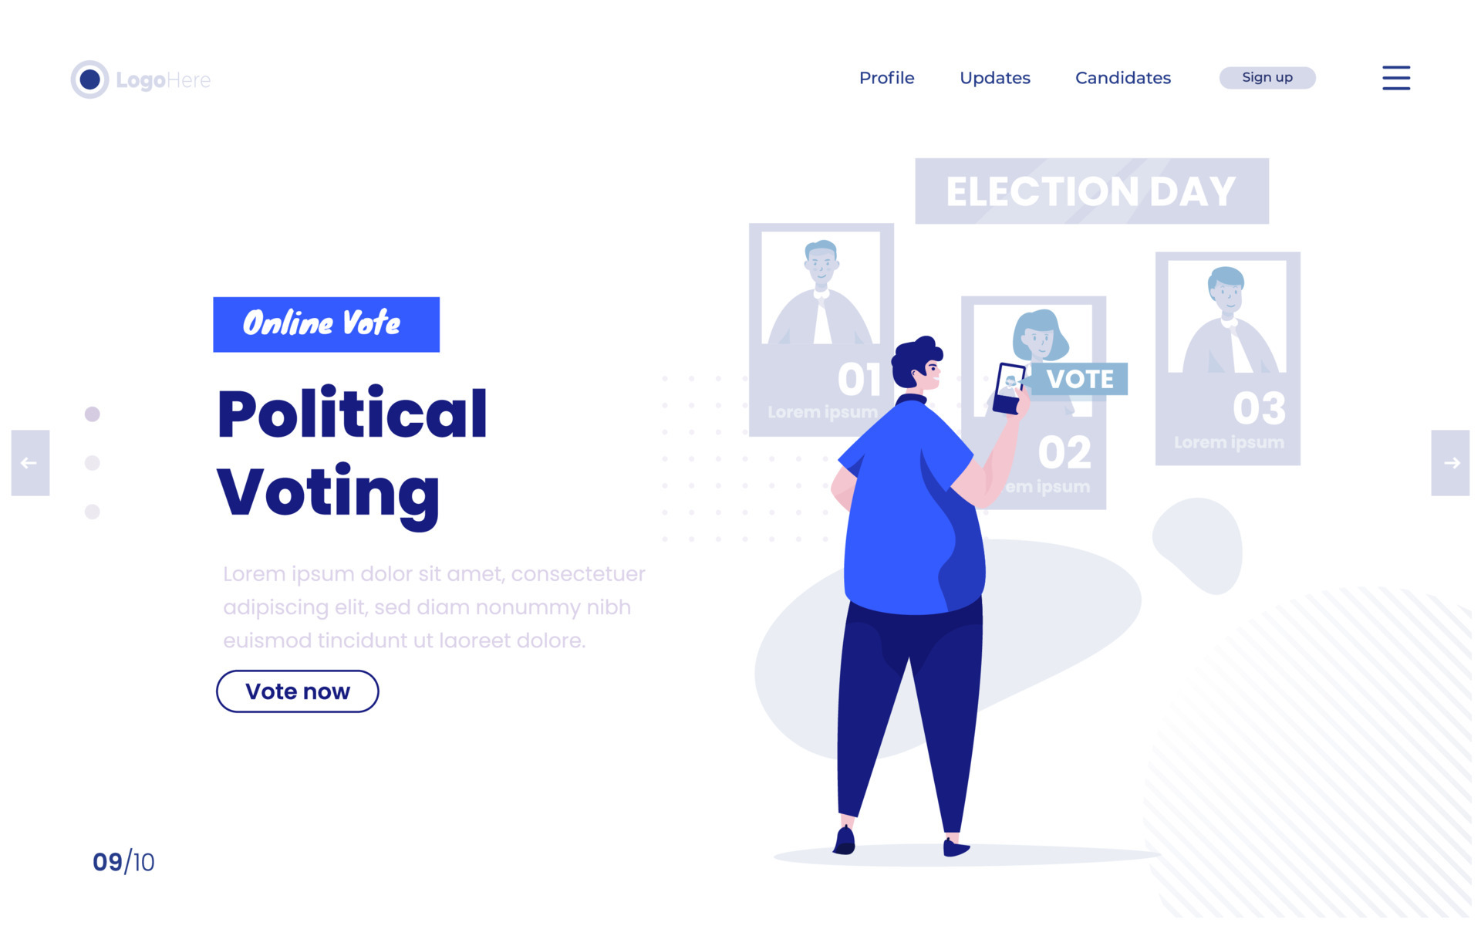
Modelling & Results
Source :

Slide 11
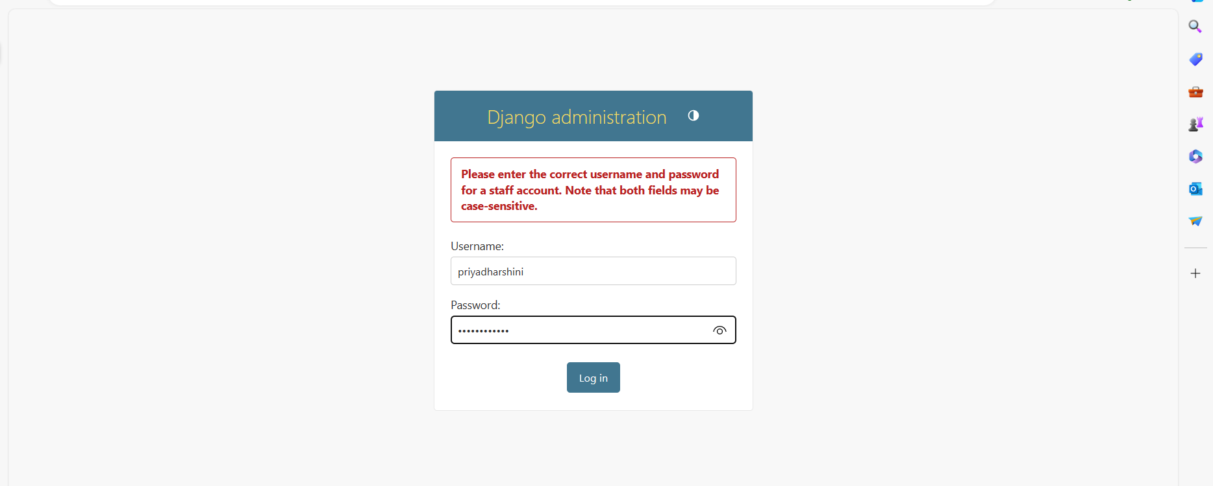
Login page

Slide 12
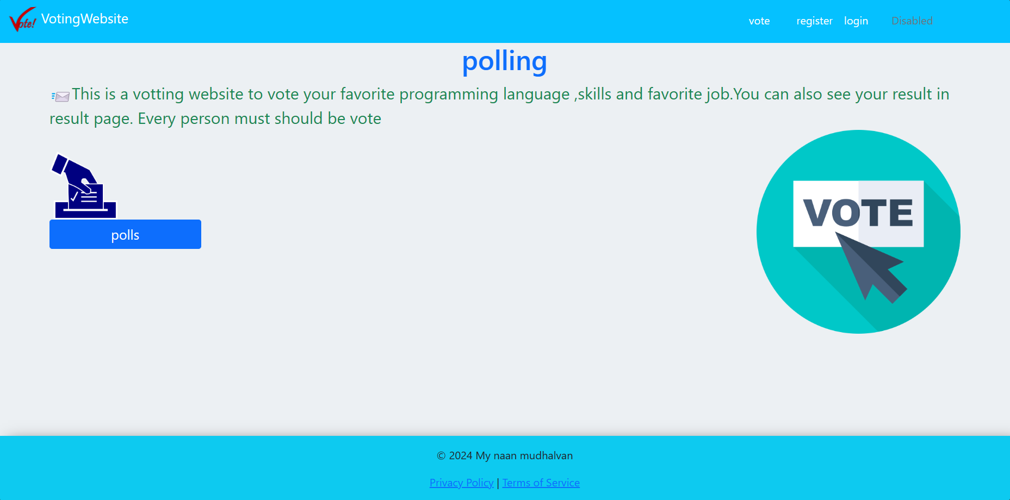
Home page

Slide 13
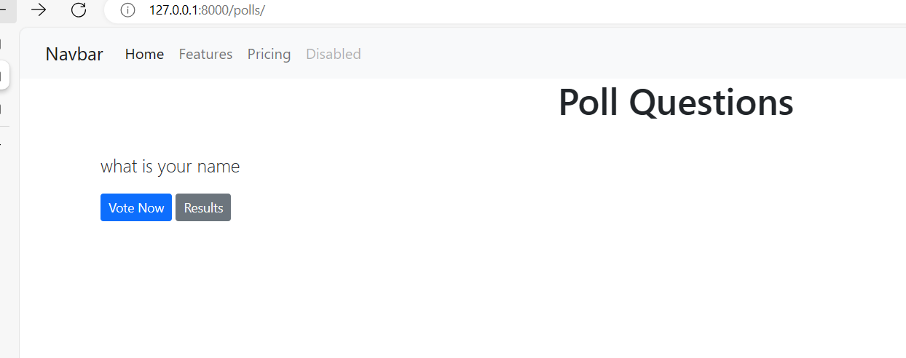
Poll questions for voting

Slide 14
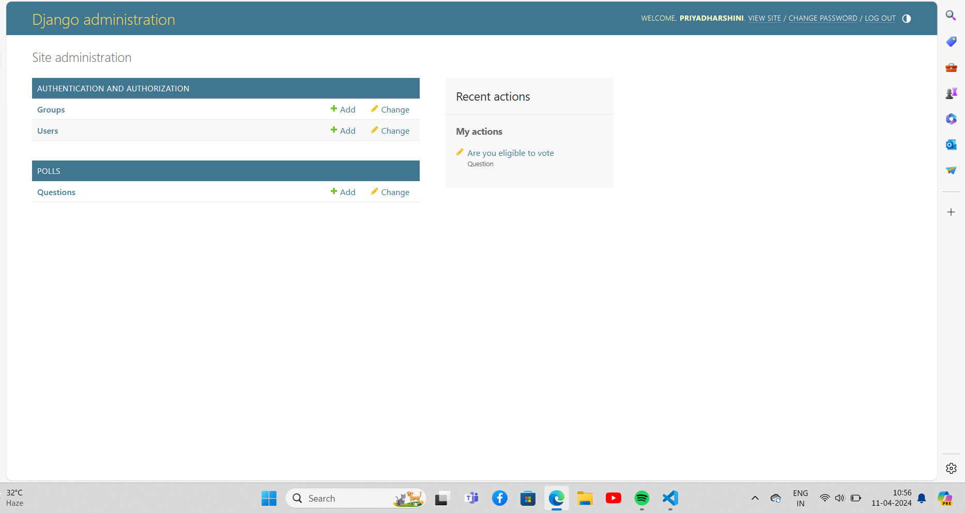
Departments/site-Page

Slide 15
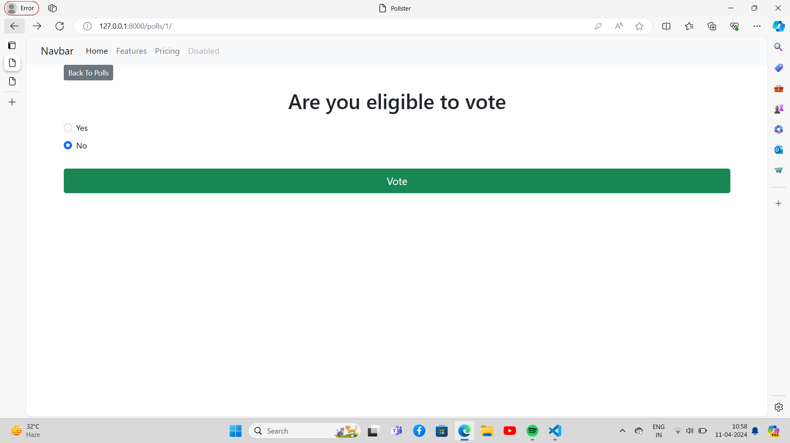
Blog-Page

Slide 16
Future Enhancements:
The challenge of developing electronic voting systems is not only security but also protecting the secrecy of the ballot, a bedrock principle of free and fair elections. Currently there is “no known technology that can guarantee the secrecy, security, and verifiability of a marked ballot transmitted over the Internet.” ¹
Online voting presents numerous vulnerabilities and is fundamentally insecure. There is potential for unobserved vote manipulation as well additional security vulnerabilities including potential denial of service attacks, malware intrusions, and privacy concerns. Online voting does not produce a paper trail for auditing.
Blockchain-based voting, which relies on a decentralized, distributed digital ledger is vulnerable to many of the security flaws inherent in internet voting, such as the potential for malware to alter votes on a voter’s local device before the ballot is transmitted and the lack of secret ballots. Online and blockchain-based voting would greatly increase the risk of undetectable, nation-scale election failures.²

Slide 17
Conclusion
Before moving on to my general conclusion, I offer first a broad summary of the various steps and components of the rather dense argument I have given in the preceding chapters.
Compulsory voting is the only really reliable and decisive means by which to raise turnout.
Elections and the way they operate are important because voting is the agreed procedure for legitimizing governments.
Source :

Slide 18
Thank You!
Notes:
Thank You !!

